Slide 1


Electric Circuits
Twelfth Edition, Global Edition
Chapter 4 – Part 3
Techniques of Circuit Analysis
© 2024 Pearson Education Ltd. All Rights Reserved.
Notes:
If this PowerPoint presentation contains mathematical equations, you may need to check that your computer has the following installed:
1) Math Type Plugin
2) Math Player (free versions available)
3) NVDA Reader (free versions available)

Slide 2
Chapter 4 – techniques of circuit analysis (1 of 13)
The mesh current method:
  The dual of the node voltage method
  Uses K V L equations around meshes
  Solves directly for currents
  Special cases for dependent sources and for current sources in a mesh.

Slide 3
Chapter 4 – techniques of circuit analysis (2 of 13)
The basic mesh current method recipe:
  Step 1 – Identify the meshes with curved directed arrows that follow the perimeter of each mesh.
  Step 2 – Label the mesh currents for each mesh.
  Step 3 – Write a K V L equation for each mesh.
  Step 4 – Solve the K V L equations to find the mesh current values.
  Step 5 – Solve the circuit using mesh currents from Step 4 to find component currents, voltages, and power values.

Slide 4
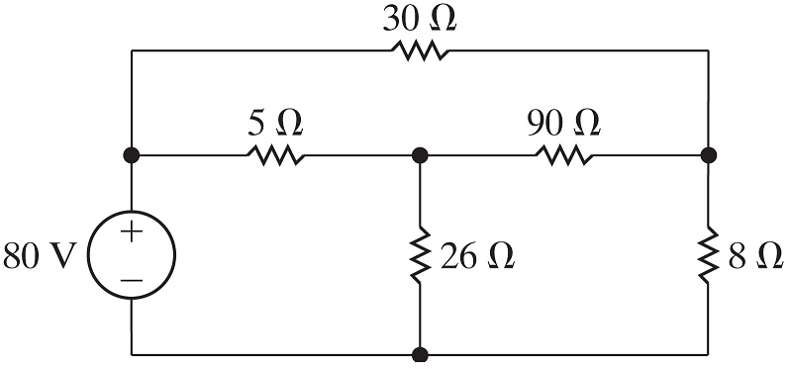
Chapter 4 – techniques of circuit analysis (3 of 13)
How many meshes does this circuit contain?
A. 1
B. 2
C. 3
D. 4

Slide 5


Chapter 4 – techniques of circuit analysis (3 of 13)
How many meshes does this circuit contain?
A. 1
B. 2
C. 3
D. 4

Slide 6


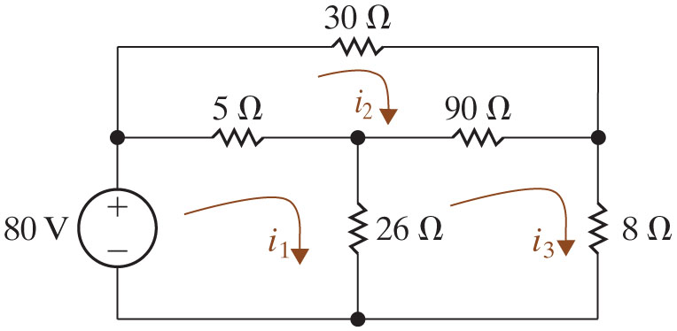
Chapter 4 – techniques of circuit analysis (4 of 13)
Find the power associated with the voltage source and the
resistor, using the mesh current method.
After Step 1 (identifying the meshes) and Step 2 (labeling the mesh currents):

Slide 7






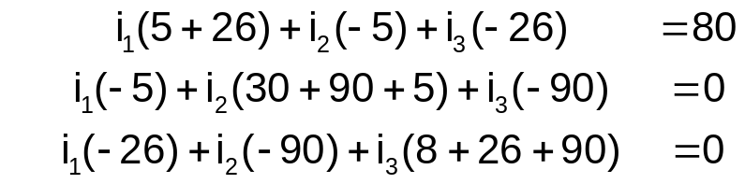



Chapter 4 – techniques of circuit analysis (5 of 13)
Find the power associated with the voltage source and the
resistor, using
the mesh current method.
Step 3 – Write a K V L equation for each mesh.
Step 4 – Solve the K V L equations to find the mesh current values.
mesh:
mesh:
mesh:
Standard form:
Solution:
Notes:
Long Description 1:
Close Parenthesis negative 80 plus 5 Open Parenthesis i subscript 1 Base Line minus i subscript 2 Base Line Close Parenthesis plus 26 Open Parenthesis i subscript 1 Base Line minus i subscript 3 Base Line Close Parenthesis equals 0.Close Parenthesis
Long Description 2:
Close Parenthesis30 Open Parenthesis i subscript 2 Base Line Close Parenthesis plus 90 Open Parenthesis i subscript 2 Base Line minus i subscript 3 Base Line Close Parenthesis plus 5 Open Parenthesis i subscript 2 Base Line minus i subscript 1 Base Line Close Parenthesis equals 0.Close Parenthesis
Long Description 3:
Close Parenthesis8 Open Parenthesis i subscript 3 Base Line Close Parenthesis plus 26 Open Parenthesis i subscript 3 Base Line minus i subscript 1 Base Line Close Parenthesis plus 90 Open Parenthesis i subscript 3 Base Line minus i subscript 2 Base Line Close Parenthesis equals 0.Close Parenthesis
Long Description 4:
Close Parenthesis1: i subscript 1 Base Line Open Parenthesis 5 plus 26 Close Parenthesis plus i subscript 2 Base Line Open Parenthesis negative 5 Close Parenthesis plus i subscript 3 Base Line Open Parenthesis negative 26 Close Parenthesis equals 80.Close Parenthesis
Close Parenthesis2. i subscript 1 Base Line Open Parenthesis negative 5 Close Parenthesis plus i subscript 2 Base Line Open Parenthesis 30 plus 90 plus 5 Close Parenthesis plus i subscript 3 Base Line Open Parenthesis negative 90 Close Parenthesis equals 0.Close Parenthesis
Close Parenthesis3. i subscript 1 Base Line Open Parenthesis negative 26 Close Parenthesis plus i subscript 2 Base Line Open Parenthesis negative 90 Close Parenthesis plus i subscript 3 Base Line Open Parenthesis 8 plus 26 plus 90 Close Parenthesis equals 0.Close Parenthesis

Slide 8
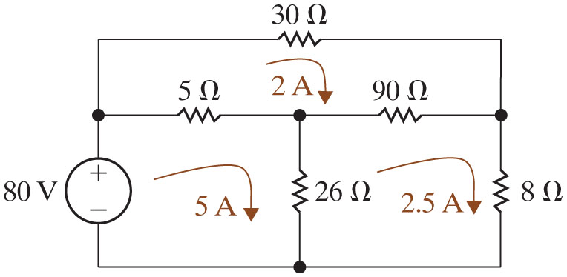










Chapter 4 – techniques of circuit analysis (6 of 13)
Step 5 – Solve the circuit using mesh currents from Step 4 to find component currents, voltages, and power values. Here we check that the power balances
Component | Equation | p[W]
80 V | −(5)(80) | −400
5 Ohms. | Open Parenthesis 5 minus 2 Close Parenthesis squared multiplied by Open Parenthesis 5 Close Parenthesis. | 45
90 Ohms. | Open Parenthesis 2.5 minus 2 Close Parenthesis squared multiplied by Open Parenthesis 90 Close Parenthesis. | 22.5
30 Ohms. | Open Parenthesis 2 Close Parenthesis squared multiplied by Open Parenthesis 30 Close Parenthesis. | 120
26 Ohms. | Open Parenthesis 5 minus 2.5 Close Parenthesis squared multiplied by Open Parenthesis 26 Close Parenthesis. | 162.5
8 Ohms. | Open Parenthesis 2.5 Close Parenthesis squared multiplied by Open Parenthesis 8 Close Parenthesis. | 50

Slide 9
Chapter 4 – techniques of circuit analysis (7 of 13)
If you were asked to use the Node Voltage method, how many equations would you write and solve?
A. 3 K C L, 0 constraint
B. 2 K C L, 1 constraint
C. 1 K C L, 2 constraint
D. 2 K C L, 0 constraint

Slide 10
Chapter 4 – techniques of circuit analysis (7 of 13)
If you were asked to use the Node Voltage method, how many equations would you write and solve?
A. 3 K C L, 0 constraint
B. 2 K C L, 1 constraint
C. 1 K C L, 2 constraint
D. 2 K C L, 0 constraint

Slide 11
Chapter 4 – techniques of circuit analysis (8 of 13)
Mesh current method, special cases:
  Dependent sources
  Current source on the perimeter of a mesh
  Current source shared between two meshes

Slide 12
Chapter 4 – techniques of circuit analysis (9 of 13)
Modify the mesh current analysis method to handle circuits with dependent sources:
  Step 1 – Identify the meshes with curved directed arrows that follow the perimeter of each mesh.
  Step 2 – Label the mesh currents for each mesh.
  Step 3 – Write a K V L equation for each mesh.
    If there are dependent sources, write a dependent source constraint equation for each.
  Step 4 – Solve the K V L equations to find the mesh current values.
  Step 5 – Solve the circuit using mesh currents from Step 4 to find component currents, voltages, and power values.

Slide 13

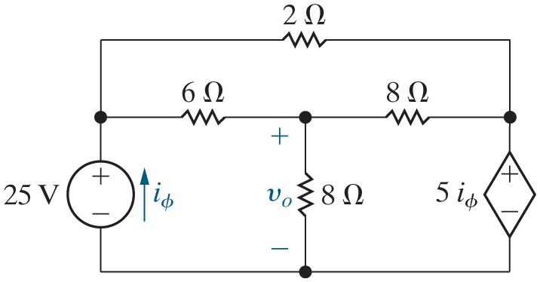
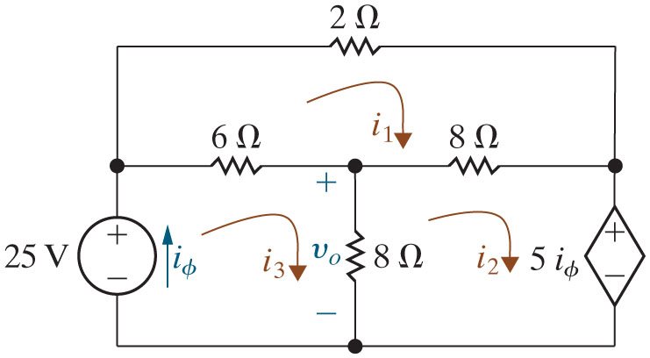
Chapter 4 – techniques of circuit analysis (10 of 13)
Find
using the mesh current method.
After Steps 1 and 2:

Slide 14







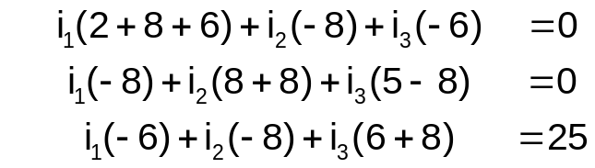



Chapter 4 – techniques of circuit analysis (11 of 13)
Find
using the mesh current method.
Write the K V L and dependent source equations (Step 3) and solve them (Step 4).
mesh:
mesh:
mesh:
constraint:
Standard form:
Solution:
Notes:
Long Description 1:
Close Parenthesis2 i subscript 1 Base Line plus 8 Open Parenthesis i subscript 1 Base Line minus i subscript 2 Base Line Close Parenthesis plus 6 Open Parenthesis i subscript 1 Base Line minus i subscript 3 Base Line Close Parenthesis equals 0.Close Parenthesis
Long Description 2:
Close Parenthesis5 i subscript Phi Base Line plus 8 Open Parenthesis i subscript 2 Base Line minus i subscript 3 Base Line Close Parenthesis plus 8 Open Parenthesis i subscript 2 Base Line minus i subscript 1 Base Line Close Parenthesis equals 0.Close Parenthesis
Long Description 3:
Close Parenthesis negative 25 plus 6 Open Parenthesis i subscript 3 Base Line minus i subscript 1 Base Line Close Parenthesis plus 8 Open Parenthesis i subscript 3 Base Line minus i subscript 2 Base Line Close Parenthesis equals 0.Close Parenthesis
Long Description 4:
Close Parenthesis1. i subscript 1 Base Line Open Parenthesis 2 plus 8 plus 6 Close Parenthesis plus i subscript 2 Base Line Open Parenthesis negative 8 Close Parenthesis plus i subscript 3 Base Line Open Parenthesis negative 6 Close Parenthesis equals 0.Close Parenthesis
Close Parenthesis2. i subscript 1 Base Line Open Parenthesis negative 8 Close Parenthesis plus i subscript 2 Base Line Open Parenthesis 8 plus 8 Close Parenthesis plus i subscript 3 Base Line Open Parenthesis 5 minus 8 Close Parenthesis equals 0.Close Parenthesis
Close Parenthesis3. i subscript 1 Base Line Open Parenthesis negative 6 Close Parenthesis plus i subscript 2 Base Line Open Parenthesis negative 8 Close Parenthesis plus i subscript 3 Base Line Open Parenthesis 6 plus 8 Close Parenthesis equals 25.Close Parenthesis

Slide 15





Chapter 4 – techniques of circuit analysis (12 of 13)
If
and
find
A. 16 V
B. 32 V
C. 2 V
D. −16 V

Slide 16
Chapter 4 – techniques of circuit analysis (12 of 13)
If
and
find
A. 16 V
B. 32 V
C. 2 V
D. −16 V

Slide 17
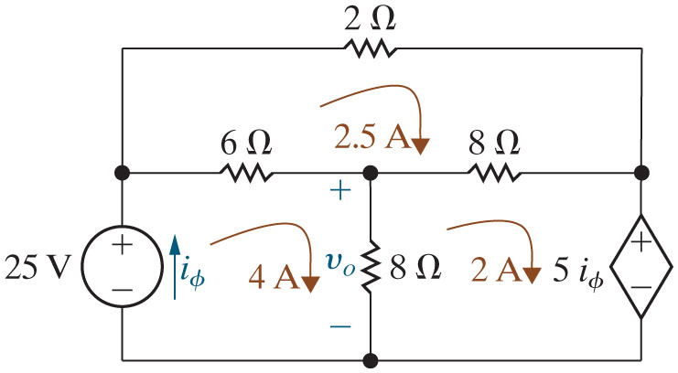









Chapter 4 – techniques of circuit analysis (13 of 13)
Step 5 – Solve the circuit using mesh currents from Step 4 to find component currents, voltages, and power values.
Power balance:
Component | Equation | p [W]
25 V | −(4)(25) | −100
Dep. Source | (2) [5(4)] | 40
6 Ohms. | Open Parenthesis 4 minus 2.5 Close Parenthesis squared multiplied by Open Parenthesis 6 Close Parenthesis. | 13.5
2 Ohms. | Open Parenthesis 2.5 Close Parenthesis squared multiplied by Open Parenthesis 2 Close Parenthesis. | 12.5
8 Ohms Open Parenthesis middle Close Parenthesis. | Open Parenthesis 4 minus 2 Close Parenthesis squared multiplied by Open Parenthesis 8 Close Parenthesis. | 32
8 Ohms Open Parenthesis right Close Parenthesis. | Open Parenthesis 2 minus 2.5 Close Parenthesis squared multiplied by Open Parenthesis 8 Close Parenthesis. | 2

Slide 18

Copyright
This work is protected by United Kingdom copyright laws and is provided solely for the use of instructors in teaching their courses and assessing student learning. Dissemination or sale of any part of this work (including on the World Wide Web) will destroy the integrity of the work and is not permitted. The work and materials from it should never be made available to students except by instructors using the accompanying text in their classes. All recipients of this work are expected to abide by these restrictions and to honor the intended pedagogical purposes and the needs of other instructors who rely on these materials.

